Slide 1
RFM Analysis
Using RFM Analysis, a business can assess customer's:
recency (the date they made their last purchase)
frequency (how often they make purchases)
monetary value (the amount spent on purchases)
We cab divide Customers into 3 Value segments based on average RFM Score as follows:
High-Value (Top 20%)
Mid-Value (Next 30%)
Low-Value (Next 50%)
When segmenting customers based on RFM (Recency, Frequency, Monetary), we can create customer segments that reflect their purchasing behavior. Here are five segment names we can consider:

Slide 2
VIP Customers: This segment represents the high-value customers who have made recent and frequent purchases with a high monetary value. They are the most valuable and loyal customers.
Regular Customers: This segment includes customers who make frequent purchases but may not have the highest monetary value. They are reliable and contribute to consistent sales.
Dormant Customers: This segment consists of customers who haven't made a purchase in a while, despite having a history of previous purchases. These customers may require targeted marketing efforts to reactivate them.
New Customers: This segment represents customers who have recently made their first purchase. They require nurturing and engagement to encourage repeat purchases and long-term loyalty.
Churned Customers: This segment comprises customers who were once active but haven't made a purchase in a long time. They require re-engagement strategies to win them back and prevent them from churning

Slide 3
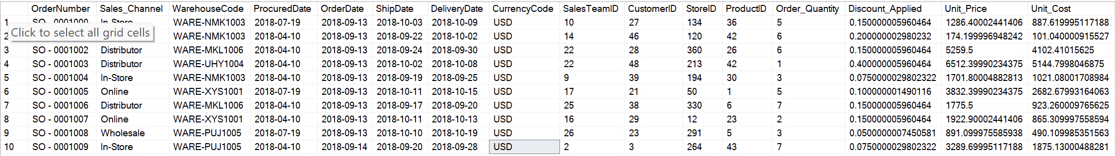
SELECT TOP (10) *
FROM [e-ommercce data ].[dbo].[US_Regional_Sales_Data];

Slide 4

#Calculate range of dates
Select
MAX(OrderDate) AS MAX,
MIN(OrderDate) AS MIN
FROM [e-ommercce data ].[dbo].[US_Regional_Sales_Data]

Slide 5
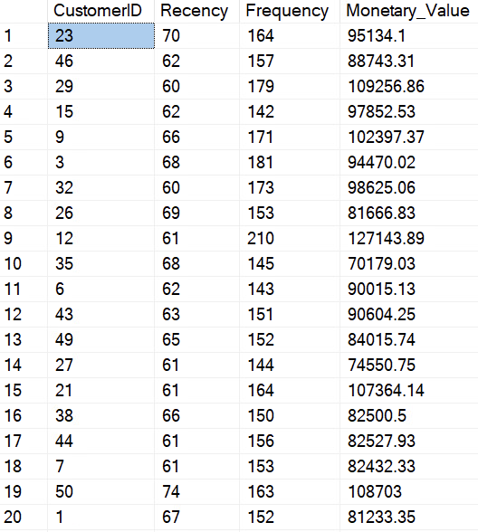
DECLARE @today_date AS DATE = '2021-01-31’;
Calculating the RFM
SELECT
CustomerID AS CustomerID
,Datediff(day,MAX(OrderDate),@today_date) AS Recency
,Count(OrderNumber) AS Frequency
,Sum([Unit_Price]* (1 - [Discount_Applied]) - [Unit_Cost]) AS Monetary_Value
FROM [e-ommercce data ].[dbo].[US_Regional_Sales_Data]
GROUP BY CustomerID;

Slide 6
Distribution of RFM Values by Five Number Summary
With a as (
SELECT
CustomerID AS CustomerID
,Datediff(day,MAX(OrderDate),'2021-02-28') AS Recency
,Count(OrderNumber) AS Frequency
,cast(Sum([Unit_Price]* (1 - [Discount_Applied]) - [Unit_Cost]) as decimal(16,2)) AS Monetary_Value
FROM [e-ommercce data ].[dbo].[US_Regional_Sales_Data]
GROUP BY CustomerID
), b as
(
select MIN(Recency) as RMIN,
MAX(Recency) as RMAX,
MIN(Frequency) as FMIN,
MAX(Frequency) as FMAX,
MIN(Monetary_Value) as MMIN,
MAX(Monetary_Value) as MMAX
from a
)

Slide 7
Select Distinct
'Monetary_Value' as RFM,
b.MMIN as MIN,
PERCENTILE_DISC(0.25) WITHIN GROUP (ORDER BY Monetary_Value) OVER () as [25%],
PERCENTILE_DISC(0.5) WITHIN GROUP (ORDER BY Monetary_Value) OVER () as [50%],
PERCENTILE_DISC(0.75) WITHIN GROUP (ORDER BY Monetary_Value) OVER () as [75%],
b.MMAX as MAX
from b join a on 1 = 1
union
Select Distinct
'Frequency' as RFM,
b.FMIN as MIN,
PERCENTILE_DISC(0.25) WITHIN GROUP (ORDER BY Frequency) OVER () as [25%],
PERCENTILE_DISC(0.5) WITHIN GROUP (ORDER BY Frequency) OVER () as [50%],
PERCENTILE_DISC(0.75) WITHIN GROUP (ORDER BY Frequency) OVER () as [75%],
b.FMAX as MAX
from b join a on 1 = 1
union
Select Distinct
'Recency' as RFM,
b.RMIN as MIN,
PERCENTILE_DISC(0.25) WITHIN GROUP (ORDER BY Recency) OVER () as [25%],
PERCENTILE_DISC(0.5) WITHIN GROUP (ORDER BY Recency) OVER () as [50%],
PERCENTILE_DISC(0.75) WITHIN GROUP (ORDER BY Recency) OVER () as [75%],
b.RMAX as MAX
from b join a on 1 = 1

Slide 8
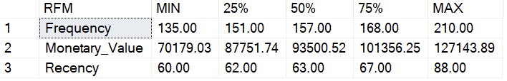

Slide 9
Partition RFM Values on the scale of 1 to 5 scores
With a as (
SELECT
CustomerID AS CustomerID
,Datediff(day,MAX(OrderDate),'2021-02-28') AS Recency
,Count(OrderNumber) AS Frequency
,cast(Sum([Unit_Price]* (1 - [Discount_Applied]) - [Unit_Cost]) as decimal(16,2)) AS Monetary_Value
FROM [e-ommercce data ].[dbo].[US_Regional_Sales_Data]
GROUP BY CustomerID
)
select
*,
NTILE(5) Over(order by recency desc) as Recency_Score,
NTILE(5) Over(order by Frequency) as Frequency_Score,
NTILE(5) Over(order by Monetary_Value) as Monetary_Value_Score
from a

Slide 10
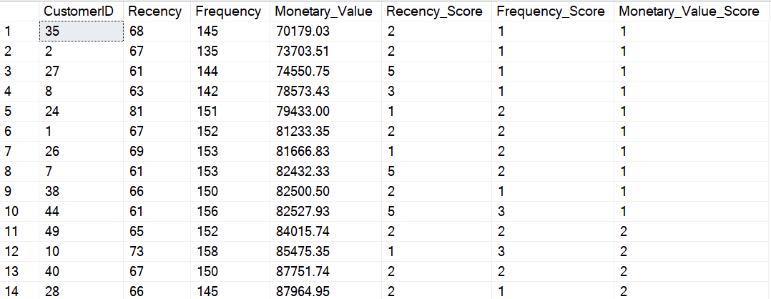

Slide 11
Let’s store the above result into a temporary table
With a as (
SELECT
CustomerID AS CustomerID
,Datediff(day,MAX(OrderDate),'2021-02-28') AS Recency
,Count(OrderNumber) AS Frequency
,cast(Sum([Unit_Price]* (1 - [Discount_Applied]) - [Unit_Cost]) as decimal(16,2)) AS Monetary_Value
FROM [e-ommercce data ].[dbo].[US_Regional_Sales_Data]
GROUP BY CustomerID
)
select
*,
NTILE(5) Over(order by recency) as Recency_Score,
NTILE(5) Over(order by Frequency) as Frequency_Score,
NTILE(5) Over(order by Monetary_Value) as Monetary_Value_Score
into #RFM_segment
from a
Select * from #RFM_segment1

Slide 12
Checking the Ranges of RFM by Scores using the temp table
with a as (
Select ROW_NUMBER() over(order by Recency_score) as I,
Recency_score,
min(Recency) as RMin,
max(Recency) as RMax
from #RFM_segment1
group by Recency_score),
b as(
Select ROW_NUMBER() over(order by Frequency_Score) as I,
Frequency_Score,
min(Frequency) as FMin,
max(Frequency) as FMax
from #RFM_segment1
group by Frequency_Score),
c as(
Select ROW_NUMBER() over(order by Monetary_Value_Score) as I,
Monetary_Value_Score,
min(Monetary_Value) as MMin,
max(Monetary_Value) as MMax
from #RFM_segment1
group by Monetary_Value_Score)

Slide 13
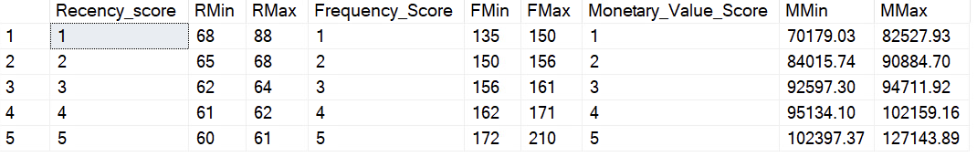
select
Recency_score, RMin, RMax,
Frequency_Score, FMin, FMax,
Monetary_Value_Score, MMin, MMax
from a join b
on a.I = b.I
join c
on a.I = c.I

Slide 14
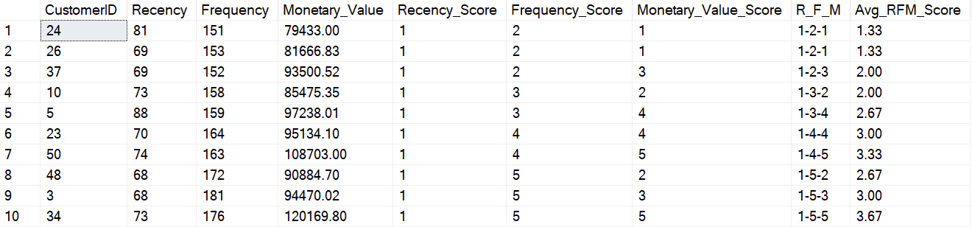
Create the Value Segments & Customer Segments based on RFM Score & Average RFM Score
Select *,
CONCAT_WS('-',Recency_Score,Frequency_Score, Monetary_Value_Score) AS R_F_M
,CAST((CAST(Recency_Score AS Float) + Frequency_Score + Monetary_Value_Score)/3 AS DECIMAL(16,2)) AS Avg_RFM_Score
from #RFM_segment1
order by R_F_M

Slide 15
with a as(
Select *,
CONCAT_WS('-',Recency_Score,Frequency_Score, Monetary_Value_Score) AS R_F_M
,CAST((CAST(Recency_Score AS Float) + Frequency_Score + Monetary_Value_Score)/3 AS DECIMAL(16,2)) AS Avg_RFM_Score
from #RFM_segment1)
Select *
, CASE WHEN Avg_RFM_Score >= 4 THEN 'High Value'
WHEN Avg_RFM_Score >= 2.5 AND Avg_RFM_Score < 4 THEN 'Mid Value'
WHEN Avg_RFM_Score > 0 AND Avg_RFM_Score < 2.5 THEN 'Low Value'
END AS Value_Seg --Value Segment
, CASE WHEN Frequency_Score >= 4 and Recency_Score >= 4 and Monetary_Value_Score >= 4 THEN 'VIP'
WHEN Frequency_Score >= 3 and Monetary_Value_Score < 4 THEN 'Regular'
WHEN Recency_Score <= 3 and Recency_Score > 1 THEN 'Inactive'
WHEN Recency_Score = 1 THEN 'Churned'
WHEN Recency_Score >= 4 and Frequency_Score <= 4 THEN 'New Customer'
END AS Cust_Seg --Customer Segment
FROM a order by R_F_M

Slide 16
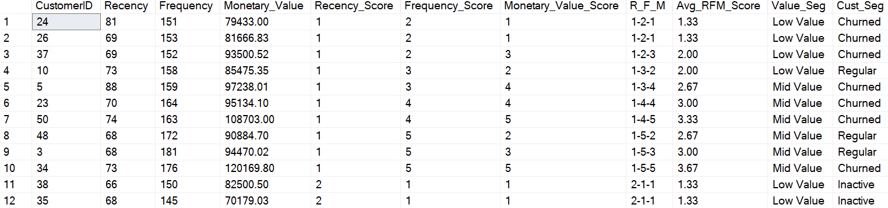

Slide 17
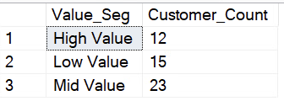
with a as(
Select *,
CONCAT_WS('-',Recency_Score,Frequency_Score, Monetary_Value_Score) AS R_F_M
,CAST((CAST(Recency_Score AS Float) + Frequency_Score + Monetary_Value_Score)/3 AS DECIMAL(16,2)) AS Avg_RFM_Score
from #RFM_segment1),
b as(
Select *
, CASE WHEN Avg_RFM_Score >= 4 THEN 'High Value'
WHEN Avg_RFM_Score >= 2.5 AND Avg_RFM_Score < 4 THEN 'Mid Value'
WHEN Avg_RFM_Score > 0 AND Avg_RFM_Score < 2.5 THEN 'Low Value'
END AS Value_Seg --Value Segment
, CASE WHEN Frequency_Score >= 4 and Recency_Score >= 4 and Monetary_Value_Score >= 4 THEN 'VIP'
WHEN Frequency_Score >= 3 and Monetary_Value_Score < 4 THEN 'Regular'
WHEN Recency_Score <= 3 and Recency_Score > 1 THEN 'Inactive'
WHEN Recency_Score = 1 THEN 'Churned'
WHEN Recency_Score >= 4 and Frequency_Score <= 4 THEN 'New Customer'
END AS Cust_Seg --Customer Segment
FROM a)
SELECT
Value_Seg,
COUNT(CustomerID) AS Customer_Count
FROM b
GROUP BY Value_Seg
ORDER BY Customer_Count
We have highest Mid Value Customers (42%)

Slide 18
Distribution of Customers by Customer Segment
with a as(
Select *,
CONCAT_WS('-',Recency_Score,Frequency_Score, Monetary_Value_Score) AS R_F_M
,CAST((CAST(Recency_Score AS Float) + Frequency_Score + Monetary_Value_Score)/3 AS DECIMAL(16,2)) AS Avg_RFM_Score
from #RFM_segment1),
b as(
Select *
, CASE WHEN Avg_RFM_Score >= 4 THEN 'High Value'
WHEN Avg_RFM_Score >= 2.5 AND Avg_RFM_Score < 4 THEN 'Mid Value'
WHEN Avg_RFM_Score > 0 AND Avg_RFM_Score < 2.5 THEN 'Low Value'
END AS Value_Seg --Value Segment
, CASE WHEN Frequency_Score >= 4 and Recency_Score >= 4 and Monetary_Value_Score >= 4 THEN 'VIP'
WHEN Frequency_Score >= 3 and Monetary_Value_Score < 4 THEN 'Regular'
WHEN Recency_Score <= 3 and Recency_Score > 1 THEN 'Inactive'
WHEN Recency_Score = 1 THEN 'Churned'
WHEN Recency_Score >= 4 and Frequency_Score <= 4 THEN 'New Customer'
END AS Cust_Seg --Customer Segment
FROM a)
SELECT
Cust_Seg,
COUNT(CustomerID) AS Customer_Count
FROM b
GROUP BY Cust_Seg
ORDER BY Customer_Count

Slide 19
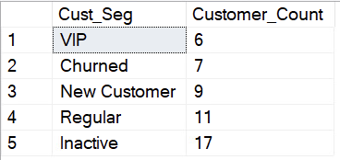
Company have highest inactive Customers (34%), 20% Regular Customers, 18% New Custoers, 16% Churned Customers & Lowest VIP Customers (12%)

Slide 20
Distribution of customers across different RFM customer segments within each value segment
with a as(
Select *,
CONCAT_WS('-',Recency_Score,Frequency_Score, Monetary_Value_Score) AS R_F_M
,CAST((CAST(Recency_Score AS Float) + Frequency_Score + Monetary_Value_Score)/3 AS DECIMAL(16,2)) AS Avg_RFM_Score
from #RFM_segment1),
b as(
Select *
, CASE WHEN Avg_RFM_Score >= 4 THEN 'High Value'
WHEN Avg_RFM_Score >= 2.5 AND Avg_RFM_Score < 4 THEN 'Mid Value'
WHEN Avg_RFM_Score > 0 AND Avg_RFM_Score < 2.5 THEN 'Low Value'
END AS Value_Seg --Value Segment
, CASE WHEN Frequency_Score >= 4 and Recency_Score >= 4 and Monetary_Value_Score >= 4 THEN 'VIP'
WHEN Frequency_Score >= 3 and Monetary_Value_Score < 4 THEN 'Regular'
WHEN Recency_Score <= 3 and Recency_Score > 1 THEN 'Inactive'
WHEN Recency_Score = 1 THEN 'Churned'
WHEN Recency_Score >= 4 and Frequency_Score <= 4 THEN 'New Customer'
END AS Cust_Seg --Customer Segment
FROM a)
SELECT
Value_Seg,
Cust_Seg,
COUNT(CustomerID) AS Customer_Count
FROM b
GROUP BY Cust_Seg,Value_Seg
ORDER BY Value_Seg,Customer_Count DESC

Slide 21
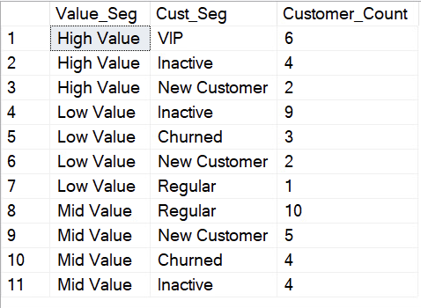
Churned Customers are equally distributed among mid value & low value customers.
Inactive Customes are distributed across all the value segments, low value segment have the maximum inactive customers.
Regular Customers are also distributed across all the value segments but majorly the Mid Value segment.
New Customers are als0 distributed across all the value segments but majorly low value & mid value segment.
55% of High Value segment customers are the VIP Customer

